Slide 1
SUSTAINABLE HOUSING, TRANSPORT & ENERGY FOR REMOTE COMMUNITIES IN THE CANADIAN ARCTIC CCTC 2013 PAPER 1569701059 WILLIAM A. ADAMS, DARRYL McMAHON, P ETER RUSSELL REMOTE ENERGY SECURITY TECHNOLOGIES COLLABORATIVE INC. (RESTCo) OTTAWA

Slide 2
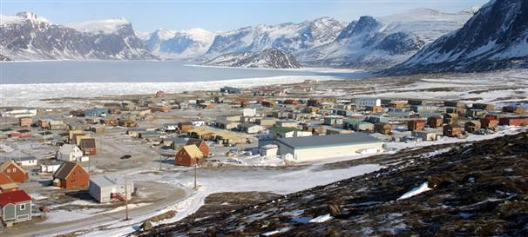
PANGNIRTUNG, NUNAVUT - POPULATION 1500,
ACCESSIBLE BY AIR & BY SHIP, ANNUALLY

Slide 3
MELTING ICE CAP > CHANGING ICE CONDITIONS > OPEN WATER > COASTAL EROSION
OCEAN RISE > COASTAL EROSION
MELTING PERMAFROST – ONSHORE > UNSTABLE GROUND > COASTAL EROSION
MELTING PERMAFROST – OFFSHORE > RELEASE OF METHANE > TROUBLE
EXTREME WEATHER (WIND AND RAIN) > BUILDING & INFRASTRUCTURE DESIGN
TEMPERATURE & INSOLATION PROFILES > BUILDING HEATING DEMAND
UNPREDICTABLE
CLIMATE-CHANGE EFFECTS ON COMMUNITIES:

Slide 4
WHY FOCUS ON REMOTE, COLD COMMUNITIES?
VERY HIGH ENERGY COSTS ~ $0.60/KWH – OFF GRID
POPULATION GROWTH
VULNERABILITY
EFFECTS OF INNOVATION EASIER TO IDENTIFY
OPTIMIZING ENERGY SUPPLY/STORAGE/DEMAND ECONOMICS
LESSONS FOR LESS REMOTE COMMUNITIES

Slide 5
POTENTIAL CHANGE IN :
ENERGY SUPPLY
TRANSPORTATION (ENERGY STORAGE)
HOUSING

Slide 6
ENERGY SUPPLY
CURRENTLY, HEATING, ELECTRICITY & TRANSPORT, ALL DEPENDENT ON OIL
PROSPECT
PRICE ESCALATION & REDUCED AVAILABILITY OF OIL
LESS WILLINGNESS OR ABILITY OF GOVERNMENTS TO PAY
CHANGING ENVIRONMENT
OPTIONS
RENEWABLES: WIND, PV, WATE – HYDRO, RIVER, TIDAL, OCEAN CURRENT, WAVE
SMALL MODULAR REACTORS
ALGAE
GAS – POSSIBILITY OF ARCTIC SOURCE
FACTORS
IMPROVEMENTS IN EROEI OF TECHNOLOGIES
RETROFIT READINESS
DIVERSITY OF SOURCES
VIABLE SCALE

Slide 7
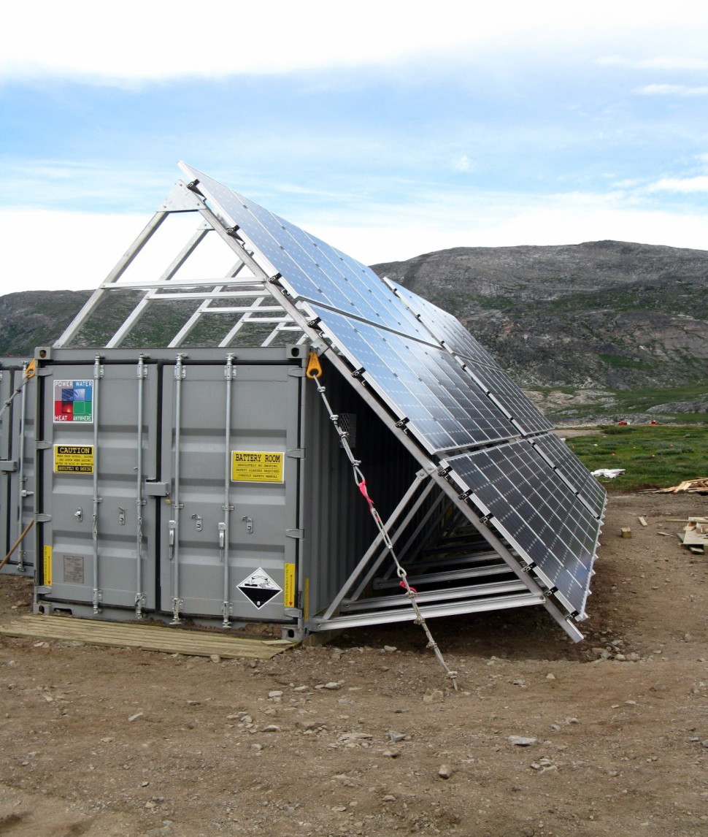
WIND FARM, KOTZBUE, ALASKA – POPULATION 3300
ECONOMAD (WINNIPEG) IN TORNGAT NATIONAL PARK, LABRADOR, 2010

Slide 8
TRANSPORTATION
PROSPECTS
MELTING PERMAFROST EFFECT ON AIR STRIPS & ICE ROADS
INCREASE COST OF OIL & OF SHIPPING IT
OPTIONS
VEHICLES: ATVs, SNOWMOBILES AND BOATS TO BE ELECTRIC
– WITH TOWED, M/G RANGE – EXTENDERS
OTHER – ELECTRIC BACKHOE!
PROSPECT OF HYBRID AIR VEHICLES
RESURGENCE OF DOG TEAMS
UNEXPECTED

Slide 9
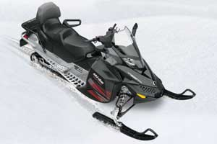

Slide 10
ENERGY DELIVERY AND STORAGE
SMART-GRID TECHNOLOGY
BATTERIES OF EV’s TO BE A SIGNIFICANT COMPONENT OF STORAGE CAPACITY
ANTICIPATE FUTURE INCREASES IN ELECTRICAL STORAGE COST-EFFECTIVENESS
SEASONAL ELECTRICAL STORAGE CAPACITY WHEN COST-EFFECTIVE
RESISTANT HEATING OF WATER AND/OR WASTEWATER FOR LOAD-LEVELLNG
COGEN UTILITY MODULES FOR CLUSTERS OF HOUSES AS BRIDGING TECHOLOGY
UNTIL RENEWABLES CAN RELIABLY SUPPLANT DIESEL ,
USE EXISTING GENERATORS TO ENSURE SECURITY OF SUPPLY

Slide 11
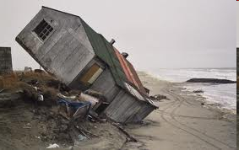

Slide 12
HOUSING
RETROFIT-READY FOR 100% ELECTRICAL OPERATION
MAXIMIZE PASSIVE & THERMAL SOLAR
MINIMIZE THERMAL LOADS – ENVELOPE LOSSES, HVAC, WATER
MINIMIZE ELECTRICAL LOADS – LIGHTING, COOKING, HEATING, OTHER APPLIANCES
MINIMIZE DETERIORATION/DEPRECIATION:
STRUCTURE/FOUNDATION SYSTEM TO AVOID SETTLEMENT OR RELOCATION DAMAGE
DAMAGE-RESISTANT SUPERSTRUCTURE
3-POINT & COMPLIANT FOUNDATIONS
EXTEND USEFUL LIFE BY OPEN-PLAN, ADAPTABLE USE & RELOCATABILITY
VERY AIRTIGHT AND DESIGNED TO STAY THAT WAY
HVAC WITH STRATIFIED VENTILATION PLUS HEAT RECOVERY
SYSTEM ACCESSIBILITY FOR UPGRADING & MAINTENANCE
SINGLE & MULTIPLE DWELLINGS – POTENTIAL OF COCOONED MODULAR CONTAINER BUILDINGS
WATER RECLAMATION
ALL SYSTEMS & MATERIALS TO BE ROBUST TO MEET REMOTENESS REQUIREMENTS

Slide 13
HOUSING PRODUCTION
ICE-FREE SEA WILL ALLOW MORE INTER-COMMUNITY SHIPPING,
MAKE IT MORE ECONOMICAL TO MANUFACTURE IN THE NORTH ,
e.g. BUILDING PANELS
NORTHERN PRODUCTION:
REDUCES SOUTH TO NORTH SHIPPING COSTS
ADDS JOBS IN THE NORTH
GREATER RESPECT SHOWN TO GOODS MADE IN THE NORTH BY NORTHERNERS
TRAINING PRIORITY

Slide 14
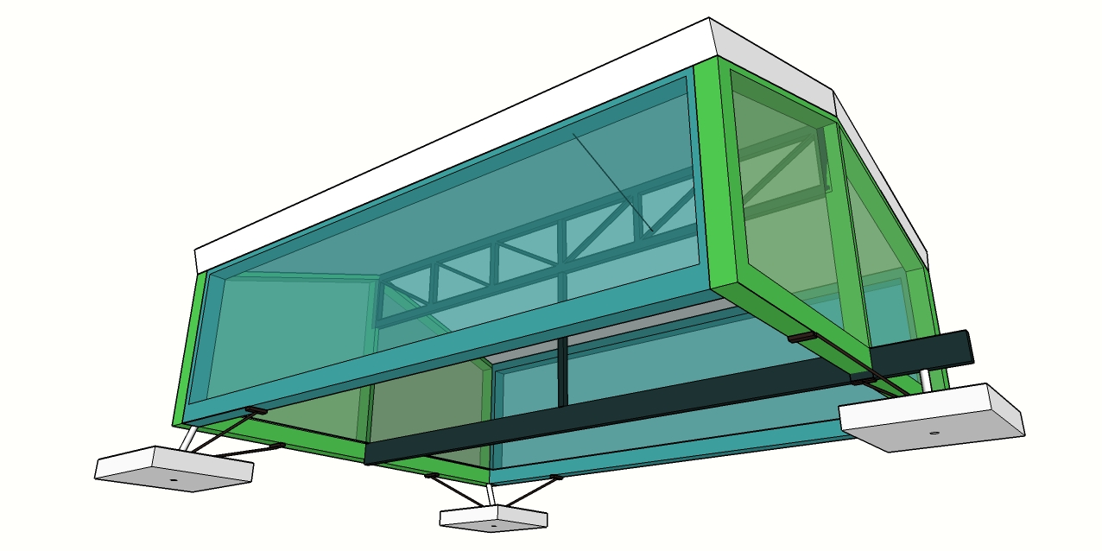
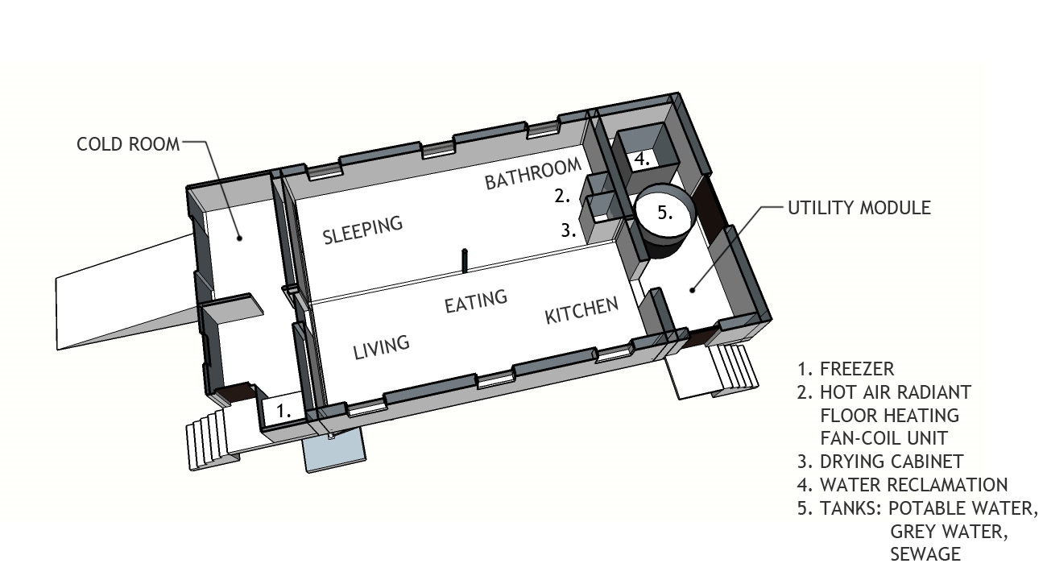

Slide 15
IMPLEMENTATION
RESTCo WILL MEET WITH THE CHIEF ADMINISTRATIVE OFFICER OF PANGNIRTUNG ON JUNE 11TH TO DISCUSS IMPLEMENTATION OF A COMMUNITY ENERGY AUDIT AND SUBSEQUENT FIRST STEP TOWARDS OIL INDEPENDENCE

Slide 16
CONCLUSIONS
ADAPTABILITY IS CRUCIAL
TRANSITION TO AN ALL-ELECTRIC COMMUNITY
MAINTENANCE OF EXISTING DIESEL CAPACITY IS VITAL
SEPARATION OF SHORT- & LONG-TERM INNOVATIONS
DIVERSITY OF RENEWABLE ENERGY SUPPLY SOURCES
COMMUNITY PLANNING MUST INVOLVE LOCAL PEOPLE
MINIMIZE COST & ENVIRONMENTAL IMPACT BY BALANCING
COST OF RENEWABLE ENERGY SUPPLY WITH COST OF DEMAND REDUCTION
USE SMART GRID, AND ENERGY STORAGE (VEHICLES)
LONGER TERM ENERGY STORAGE FOR SECURITY

